Slide 1
Data Science in Practice
Basketball Semi-finals popularity Analysis using Reddit Data

Slide 2
Introduction

Slide 3
NBA
The 2014–15 NBA season was the 69th season of the National Basketball Association (NBA).
The 2015 NBA playoffs began on Saturday, April 18, 2015 and concluded with the 2015 NBA Finals which began on June 4, 2015 on ABC.
ESPN broadcast the Western Conference Finals and TNT televised the Eastern Conference Finals.
ABC broadcast the NBA Finals.
Redditors posted comments on the events and stars

Slide 4
 | First Round |  |  |  |  | Conference Semifinals |  |  |  |  | Conference Finals |  |  |  |  | NBA Finals
 | 1 | Atlanta* | 4
 | 8 | Brooklyn | 2
 |  |  |  |  |  | 1 | Atlanta* | 4
 |  |  |  |  |  | 5 | Washington | 2
 | 4 | Toronto* | 0
 | 5 | Washington | 4
 |  |  |  |  |  |  |  |  |  |  | 1 | Atlanta* | 0
 | Eastern Conference
 |  |  |  |  |  |  |  |  |  |  | 2 | Cleveland* | 4
 | 3 | Chicago | 4
 | 6 | Milwaukee | 2
 |  |  |  |  |  | 3 | Chicago | 2
 |  |  |  |  |  | 2 | Cleveland* | 4
 | 2 | Cleveland* | 4
 | 7 | Boston | 0
 |  |  |  |  |  |  |  |  |  |  |  |  |  |  |  | E2 | Cleveland* | 2
 |  |  |  |  |  |  |  |  |  |  |  |  |  |  |  | W1 | Golden State* | 4
 | 1 | Golden State* | 4
 | 8 | New Orleans | 0
 |  |  |  |  |  | 1 | Golden State* | 4
 |  |  |  |  |  | 5 | Memphis | 2
 | 4 | Portland* | 1
 | 5 | Memphis | 4
 |  |  |  |  |  |  |  |  |  |  | 1 | Golden State* | 4
 | Western Conference
 |  |  |  |  |  |  |  |  |  |  | 2 | Houston* | 1
 | 3 | L.A. Clippers | 4
 | 6 | San Antonio | 3
 |  |  |  |  |  | 3 | L.A. Clippers | 3
 |  |  |  |  |  | 2 | Houston* | 4
 | 2 | Houston* | 4
 | 7 | Dallas | 1

Slide 5
Data
The dataset is comprised of 54.504.410 comments,
a fraction of all comments made on reddit during the month of May 2015 available publicly,
organized in a single table ‘May2015’ and provided by (Kaggle, 2015) .
Each row in the table May2015 represents a single comment,
With the following attributes:
("gilded","author_flair_text","author_flair_css_class","retrieved_on","ups","subreddit_id","edited","controversiality","parent_id","subreddit","body,"created_utc","downs","score","author","archived","distinguished","id","score_hidden","name","link_id").

Slide 6
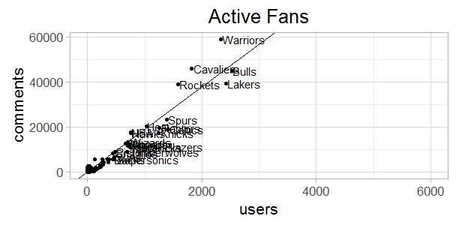
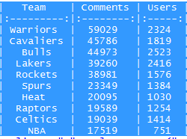
Summary & User Engagement

Slide 7
Analysis
What Happened in
Eastern/Western Confence Finals
2015-05-19, Rockets 106 - 110 Warrior
2015-05-20, Cavaliers 97 - 89 Hawks
2015-05-21, Rockets 98 - 99 Warriors
2015-05-22, Cavaliers 94 - 82 Hawks
2015-05-23, Warriors 115 - 80 Rockets
2015-05-24, Hawks 111 - 113 Cavaliers
2015-05-25, Warriors 115 -128 Houston
2015-05-26, Hawks 88 - Cavaliers 118
2015-05-27, Rockets 90- 104 Warriors
How was it reflected on Reddit

Slide 8
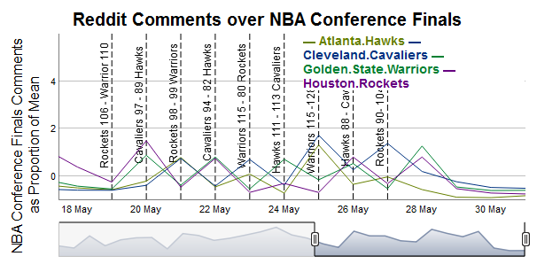

Slide 9
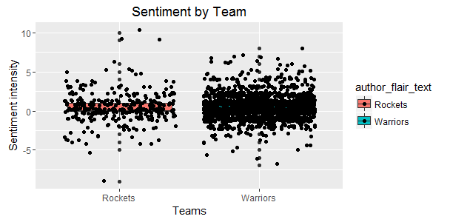

Slide 10
